Slide 1
Interim Project Pitch
By Thomas Simmons
K1906250

Slide 2
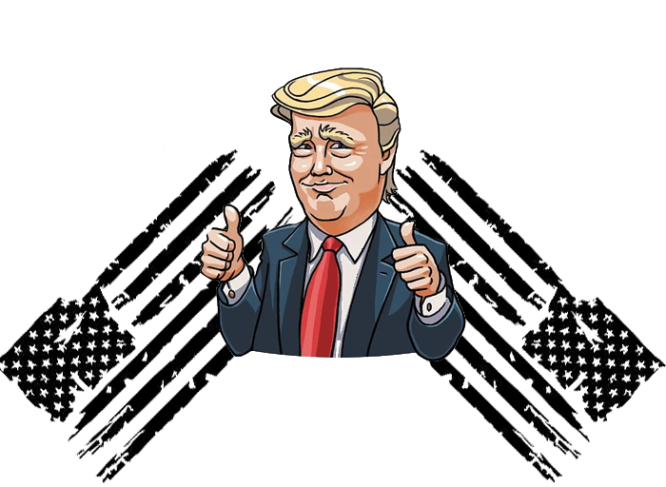
America Down Under
Very recognisable characters
All the Playable characters in Logo
Not been a Trump game of this genre
Development of the Logo

Slide 3
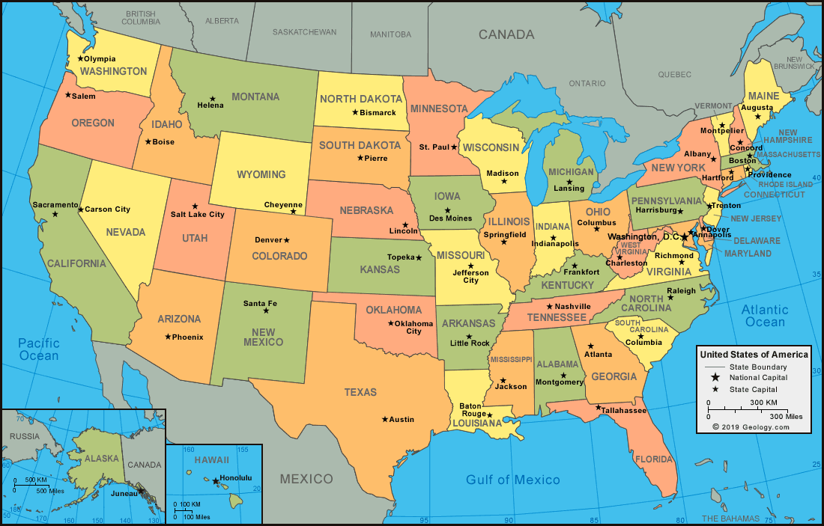
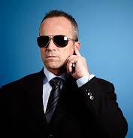
Game Outline/Story
Based in America in 2021
Political Civil War
Third Person Shooter Role Playing Game
Secret serviceman guide
Fake Allies
Corruption

Slide 4
Current Games Similar to mine What I got Inspiration from

Slide 5
Target Audience Survey Results
Used Survey Monkey and posted over social media
(Results)
(Questions Asked)

Slide 6





Target Audience/Profile
Target age of players: 16+
PEGI/ ESRB rating: 16
Players who like Tactical, Exploration & Social Games
Intended game systems: Android/Apple Mobile or console depending on survey results

Slide 7
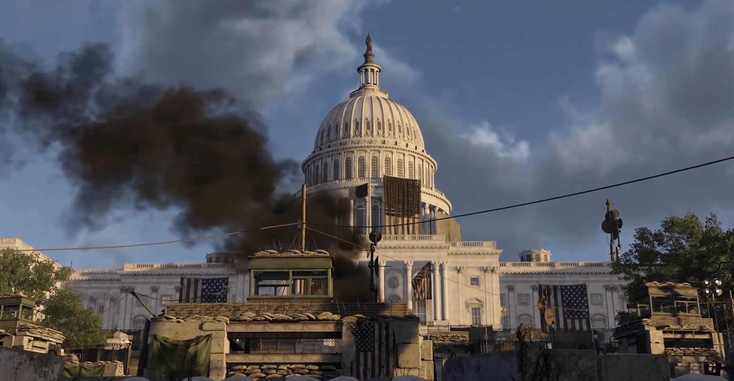
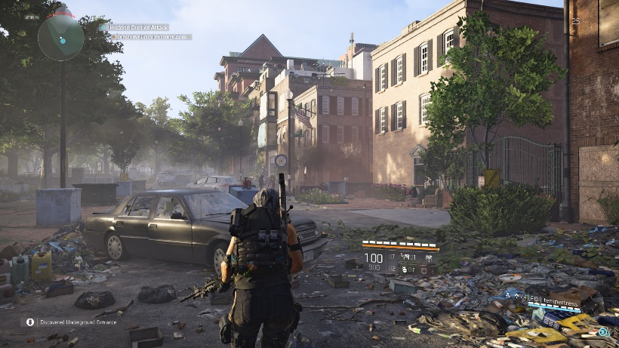
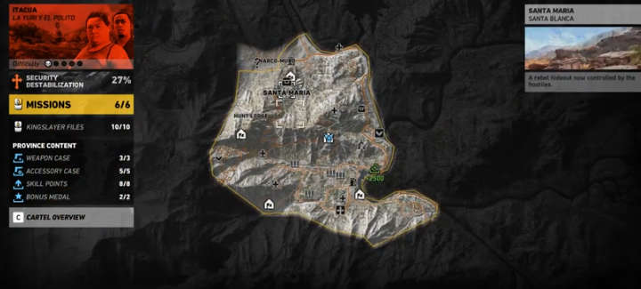
Gameplay & Environment
Moving across the map to try and escape America
Gather influence/ collectables to earn in game currency
Player character dies, respawn at last save
In the levels the player is introduced to new abilities
Empathise with rivals/enemies
Encounter Political characters/Rivals
Collect articles (Intel) objects in game

Slide 8
Game Experience
Players will feel sadness towards America and the state its in
Destruction, no hope, frustration
Signs of overgrown vegetation
Fun/ laugh towards characters being used

Slide 9
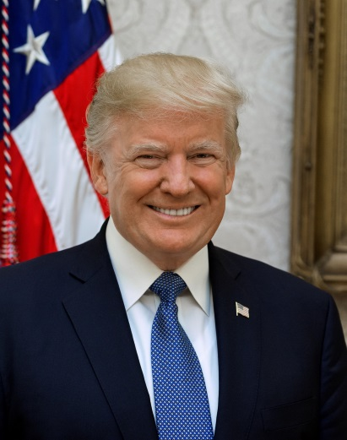
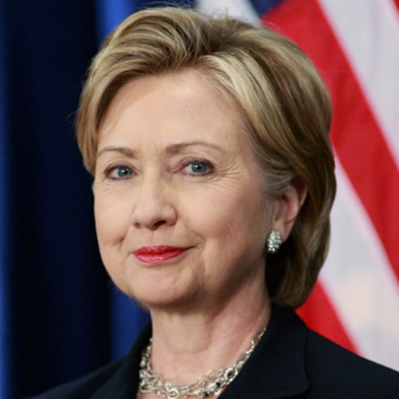
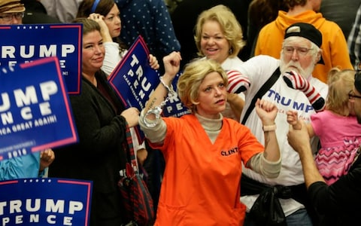
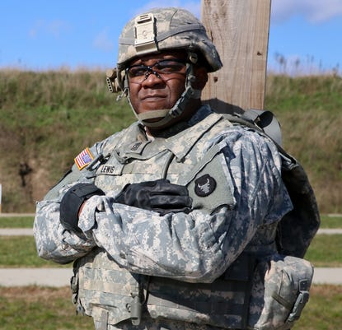
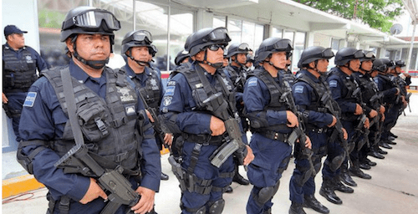
Characters
Players Characters
Allies (Trump enthusiasts/voters)
Enemies (Rival Politicians, American People)
Heroes (Party Members, Secret Service)
National Guard & Police
Mexican Police & People
Russian Influencers

Slide 10
Characters Story Arks

Slide 11
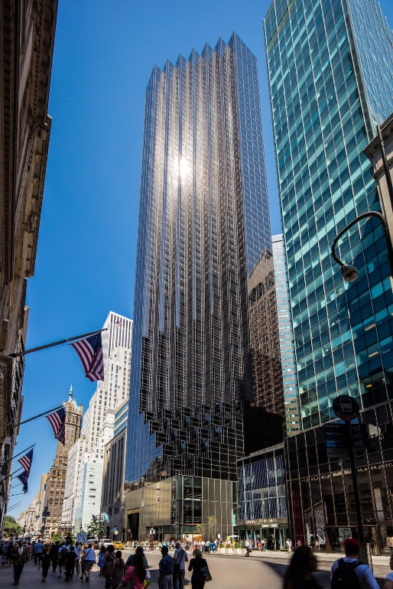
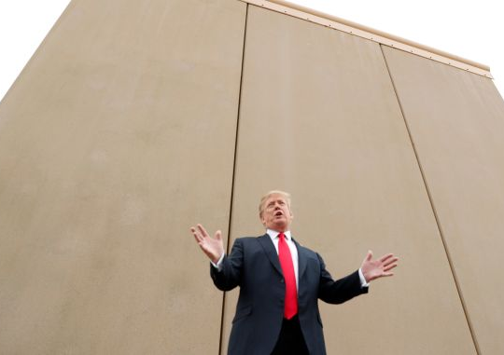
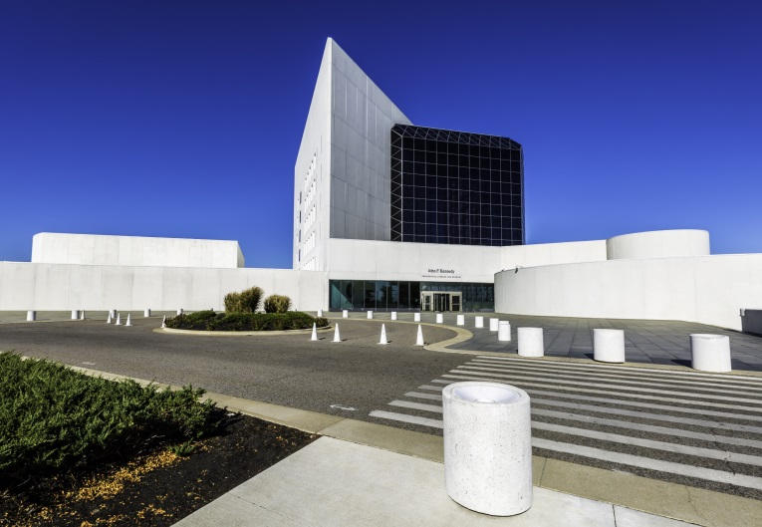
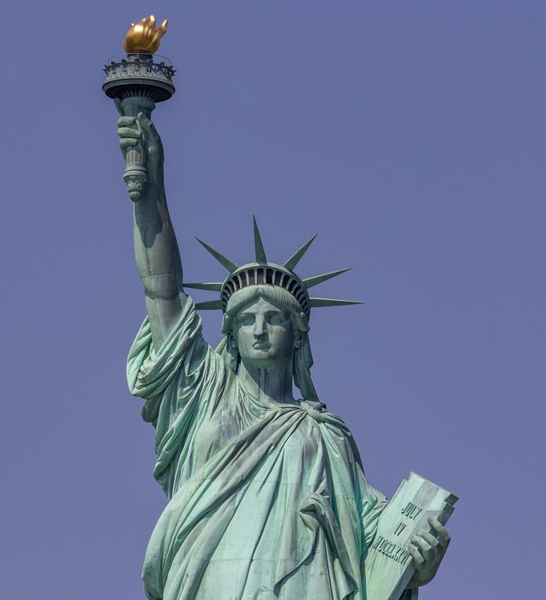
World/Locations
Iconic Buildings/ structures (Mexican wall) represented
Cities and states provide difficulty level and rewards
Map of America
Audio included in different scenarios
Find intel of real world articles/ news stories

Slide 12
Game Mechanics
Players interact with objects
Can find and pick up weapons/ armour
Encounter traps/ hazards human/ naturally made
An assistance menu/ menu

Slide 13
In Game Purchases
Purchases of different armours/ bullet proof vests
Outfits for characters
Purchased allies such as mercenaries/ secret servicemen
Loyalists/ Trump enthusiasts
Seasonal Customisations

Slide 14
Potential DLC’s

Slide 15
Questions?

